Slide 1
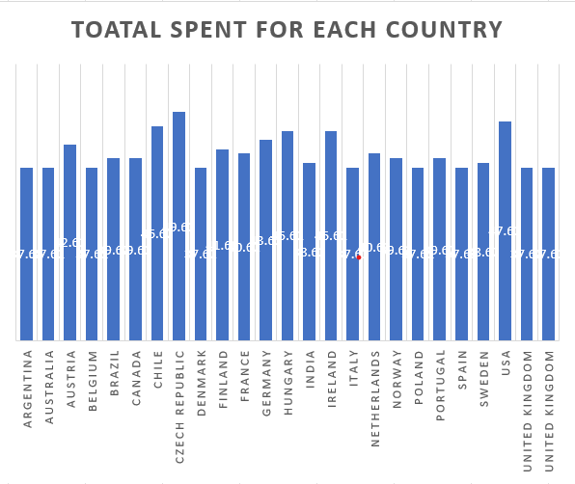
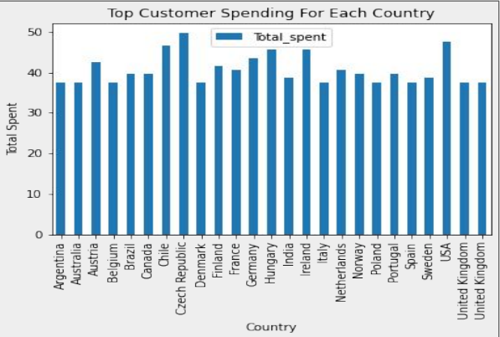
Which customer spent most ?
The customer that spent the most is Helena Holý from CZECH REPUBLIC that total spent is equal 49.62.

Slide 2
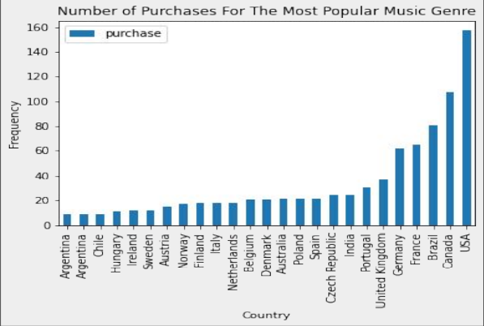
What is the number of Purchases for the most popular music Genre ?
<visualization>
The most popular genre in the USA is ‘’ROCK’’ that the total is 157 purchase.

Slide 3
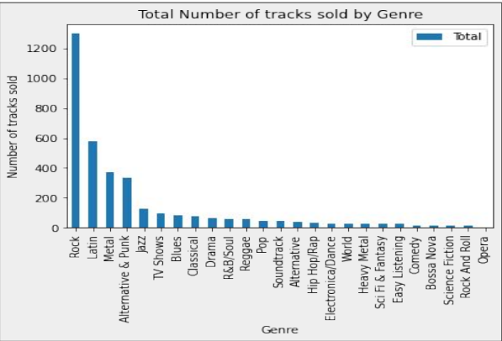
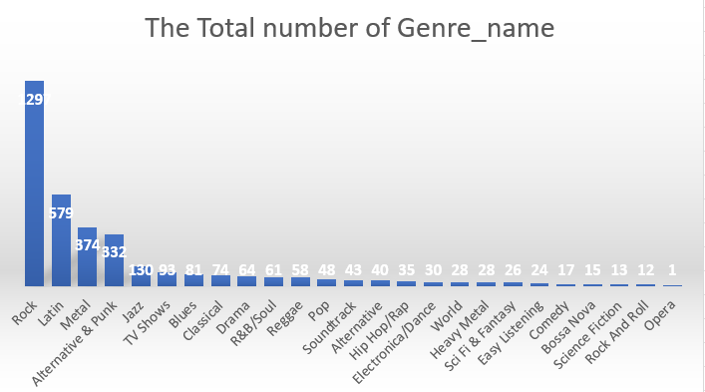
The Total number Of Genre
<visualization>
The most tracks sold for Genre is the Rock that the total sales is 1297 .
The least tracks sold for Genre is Opera that the total sales 1 .

Slide 4
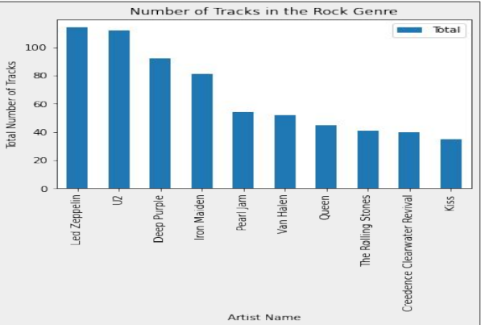
Top 10 artists that have produced the most number of tracks in the Rock genre?
The artist that produced the most number of tracks in the Rock genre is Led Zeppelin with a total of 114 tracks.

